Slide 1



BES171: Banking, Finance & Insurance
Money Evolution
Monetary Policy
Evolution & Classification of FI
Digital Payment
BASEL, NPA, TBS, Bad Bank-PARA
Finance, Insurance & Fin. Inclusion

Slide 2

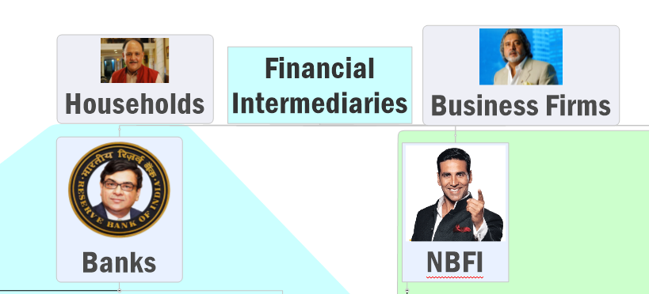
Financial intermediaries: evolution and Classification
Household
Land
Labour
Biz.Firms
Rent
Wages
Capital
Interest / Dividend / Profit

Slide 3
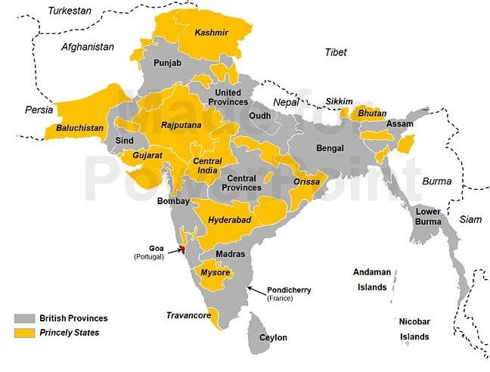

East India company: presidency banks (3)
Chronologically: North to South
Bengal
1806
Bombay
1840
Madras
1842
1861: All 3 given Right to issue currency [Lord Canning]
1881: Negotiable Instruments act [Lord Rippon] to increase acceptability of bank cheques <REF: Bank Money Lecture>

Slide 4


East India company: Presidency banks (3)->SBI
1921
Imperial Bank of India
1955
SBI (Nationalized)- initially shares to RBI, then govt.
Bengal
1806
Bombay
1840
Madras
1842
Notes:
Could be Lord Chelmsford or Lord Reading depending on which month but such Ph.d is USELESS.
6.
Transfer of assets and liabilities of the Imperial Bank to the State Bank
.
-
(1)
Subject to the other prov
isions contained in this Act, on the appointed day:
-
(a)
all share in the capital of the Imperial Bank shall be transferred to, and shall vest in
the Reserve Bank, free of all trusts, liabilities and encumbrance

Slide 5

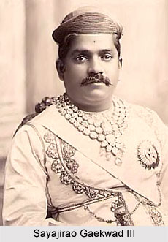
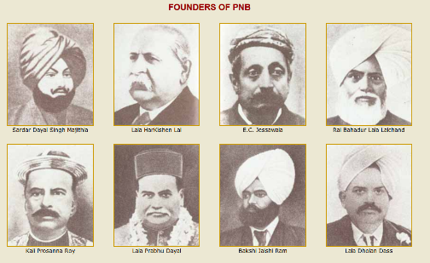

British India: DESHI banks?
1707
Bank of Hindustan, Calcutta but Europeans owned.
1865
Allahabad Bank
GROUP OF EUROPEANS
1894
PNB- Lajpat et al.
1908
BoB
Notes:
Oldest Joint Stock Bank of the Country, Allahabad Bank was founded on April 24, 1865 by a group of Europeans at Allahabad.

Slide 6
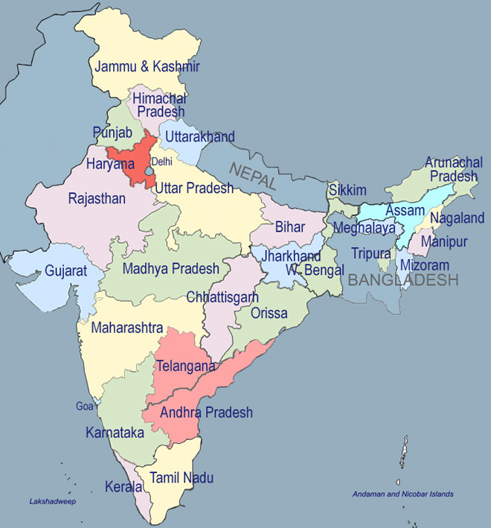
PNB: 1894
Punjab-Sind (1908)
SBPatiyala (1917)
OBC (1943)
SB Bik&Jai (40s-63)
DESHI BANK?
BMB ’13 (Delhi, the den of evil): did not follow the geographic rule, hence “पतन निश्चित था!”!!?
UCO-United Commercial ‘43
United Bank of India ’50
Bandhan Microfin’14
Overall bank network & penetration is poor = chit fund scams & poverty ? ☹
Bank of India (‘06)
Central Bank of India (‘11)
Union Bank (‘19)
RBI (’34-35)
Bank of Maharashtra (‘35)
Dena Bank (‘38)
IDFC NBFC’14
Corporation (06)
Canara Bank (’10)
SBMysore(13)
Syndicate bank (‘28)
Vijaya (‘31)
Banking industry is usually concentrated at Costal Trading centres
Andhra bank: 1923; ’41 SBHyd
TN: Indian Bank (‘23); Indian Overseas bank(‘37)
SBTravenkore’45
Notes:
*in principle approval

Slide 7

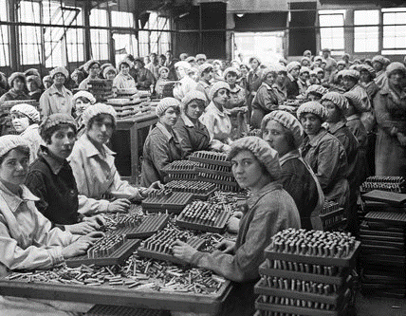
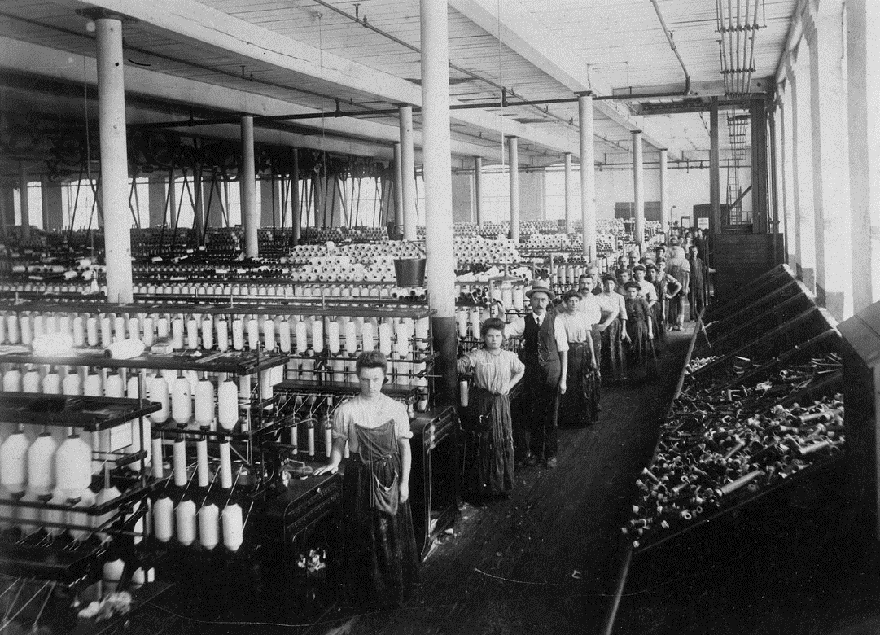
War on an industrial scale is inevitable.
All I want is to own bullets and bandages
1845-48
Mexican–American War
1856–1859
Second Opium War
1861-65
Civil War
1898
Spanish American War
1899–1901
Boxer Rebellion (China)
1917–1918
WW1
1918–1920
Russian Civil War
Notes:
War on industrial scale is inevitable.
we are only looking at wars involving usa

Slide 8
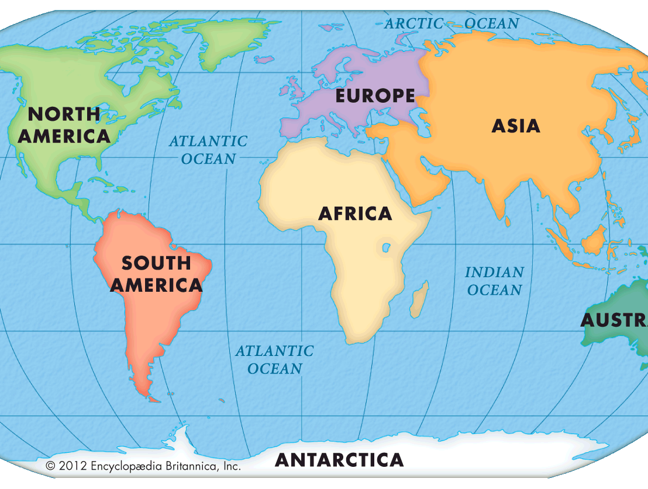




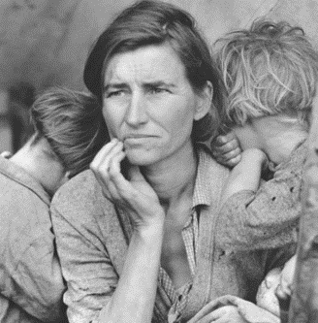
Invest/ supply
raw
Raw material
European controlled banks: bureaucrats, merchants
Swadeshi banks: merchants
Financial inclusion very poor.
Great Depression
1929- late 30s

Slide 9

Bahubali RBI the beginning
Banking Regulation
1913: companies Act- banks were registered.
1926: Hilton Young Commission – set up a ‘central bank’ called “reserve bank of India”.
1929: Great depression, USA, scores of Indian banks failed (480)
1934, March 5th: Reserve Bank of India Act.
Sir Osborne Smith
1st April 1935
Notes:
The Hilton Young Commi
ssion was a Commission of Inquiry appointed in 1927 to look into the possible closer union of the British territories in East and Central Africa.
1913-36: 480 Indian banks failed.

Slide 10



British India: RBI Act 1934
Sir Osborne Smith
1st April 1935
1st January 1949: RBI All private shares transferred to GoI under RBI transfer of ownership act ‘48
Rs. 100 (face Value) x 5 lakh = Rs. 5 cr capital
$$\frac{2200 with Government }{500000 total shares}=4.4\%$$
100%
Therefore, RBI governor answerable to Parliament, its Committees;
RBI has to pay dividend to Government from its profits
Notes:
1934: RBI
Face value Rs. 100 x 5 lakh shares= 5.cr capital
was a ___ owned bank?

Slide 11

Did not have ‘POWERS’ to regulate ALL banks.
RBI before independence
1913: Banks governed under Companies Act
1935, 1st April: RBI started op.
1935, 5th Jul : scheduled banks required to maintain CRR @RBI.
Banks with min. 5 lakh paid up capital.
Protects interests of depositors
=> Listed in 2nd Sch. Of RBI
1937: new chapter in Companies Act for Banks.
RBI Act 2nd Sch.
शर्ट भी सस्ता वाला पहेनना पड़ता था.

Slide 12
Did not have ‘POWERS’ to regulate banks.
RBI before independence
1938: Largest bank of Travancore failed.
1945: banks would invest in speculative activities of gold, metals…Defense of India Rules->RBI powers of supervision.
1947: only 96 out of 640 banks were scheduled banks…others out of CRR.
1948: RBI transfer of ownership Act
1949, Jan, 1st: RBI nationalized.
1949, March: Banking companies Act. SLR first time. -> Banking regulation act
शर्ट भी सस्ता वाला पहेनना पड़ता था.

Slide 13


With Banking Regulation Act 1949, RBI became like this..
अगर मेरे सूट पहेनने से तुम्हे ऐतराज है तो मैं सूट पहेनुंगा
The Hindu
Columnists
Reserve Bank of India
The Hindu
Columnists

Slide 14

Banking regulation Act
1949
Central banking authority
Gives license to bank and permission to open branches.
Auditing and liquidity norms. [SLR]
Protect interest of depositors. Prevent voluntary winding of licensed banks.
Force elimination and merger of weak banks. [217 wiped by 1966] <latest: Prompt Corrective Action (PCA) Framework, (Click Me for lecture).

Slide 15
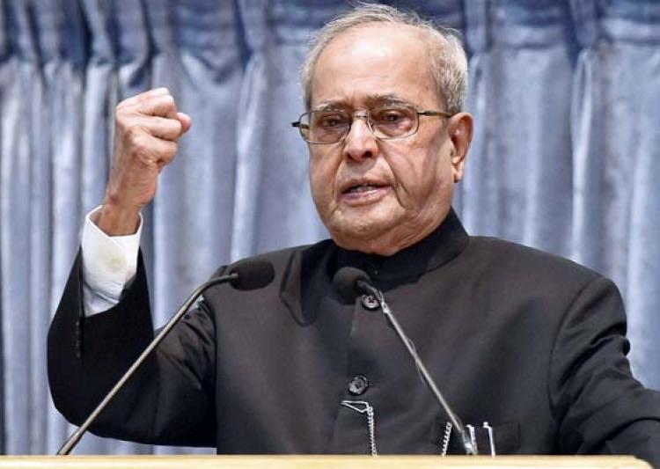
अब Loan defaulters की खैर नही!
May 2017

Slide 16


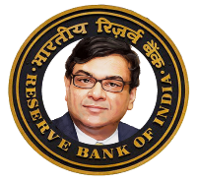

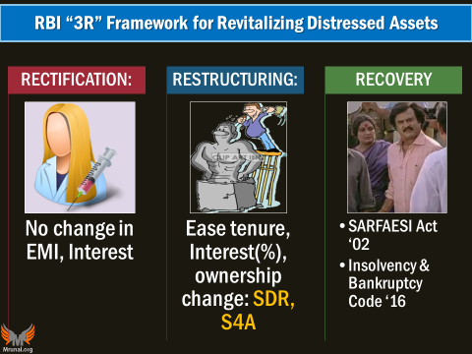
Ordinance to Banking Regulation Act 1949
Can order him
To order them
To do these things
+ RBI can appoint members on Committees related to NPA
JLF: How much “haircut”, what type of restructuring or shutdown..
SARFAESI-> asset takeover->BoD
I&B code-> Arbitration, repayment
But banks were not taking actions fearing “4C”
Notes:
1949: Banking regulation Act: RBI issues directives to all Banks
2016: I&B Code: arbitration for NPA..
2017: ordinance to banking regulation Act-
Union can order RBI to order banks to begin process against defaulter, incl. haircut, restructuring. [earlier Dilly-dallying due to “4C”]
RBI can appoint members on the resolution Committee(s) for NPA.

Slide 17
CRITICISM of NPA-Ordinance
Encroachment
Can order him
What if repayment plans are harsh on pro-Congi companies?
To order them
To do these things
+ RBI can appoint members on Committees related to NPA
If this leads to loss for the bank, who’ll be responsible?
If RBI orders takeover but what if bank can’t recover (e.g. Kingfisher)
Notes:
Government encroaching on regulators domain on NPA/sticky loans
If Government directive or RBI appointed member’s plan creates loss for the bank, who will be responsible?
What if pro-BJP industrialist gets better ‘repayment’ deal ?
RBI can order bank to takeover the biz, but what if bank is incapable to recover $ (Kingfisher airlines)

Slide 18
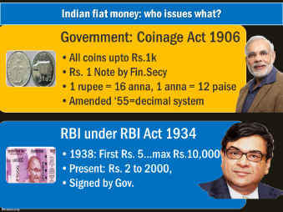
RBI: 8 functions of
All banks have “Current Account” With RBI,
E-Kuber CBS
Controller of Money Supply (MPC, RBI Act)
Controller of Foreign Exchange (FERA, FEMA) More under 3rd Pillar
Banker to Gov, Public Debt Mgmt
Banker’s Bank, Lender of Last resort
Regulator of all “BANKS” (BR Act’49), Payment Systems’07
Regulator of ”AIFI” , NBFC-D” & others.
Data, Publication , Intl. Coop (BASEL, IMF)
Customer protection, Fin.Inclusion “Promotional Roles”
Banker to two things
Controller of two things
Regulator of two things

Slide 19
UPSC prelim 2012
RBI Acts as banker’s bank. This would imply which of the following?
(CRR) Other banks retain their deposits with RBI.
(Repo) RBI lends funds to commercial banks in the times of need.
(Moral Suasion, & banker’s bank) RBI advises commercial banks on monetary matters. [Ref: Money-banking E.Narayan Nadar]
Correct Statement
Only 2 and 3
Only 1 and 2
Only 1 and 3
1, 2 and 3 (Test series “A”, Q75, Ans.D)

Slide 20
Governors of RBI
First gov
Sir Osborne Arkall Smith
First Indian
Sir CD Deshmukh
1935
1943
Participated in Bretton Woods-> GATT(WTO), IMF, World Bank
Latest
Dr. Urjit Patel
Salary 2.5 lakhs per month, [Outside 7th PC]
Notes:
While chiefs of other regulatory bodies including insurance, pension and Sebi have been earlier shortlisted by search committees, this will be the first time that RBI governor candidates will be selected by a selection committee.
The decision to conduct the next RBI governor’s slot through the financial sector regulatory appointment search committee (FSRASC) comes as a strong stance against the special treatment given to central bank chiefs and also to cool speculation over Raghuram Rajan being considered for a second term.

Slide 21
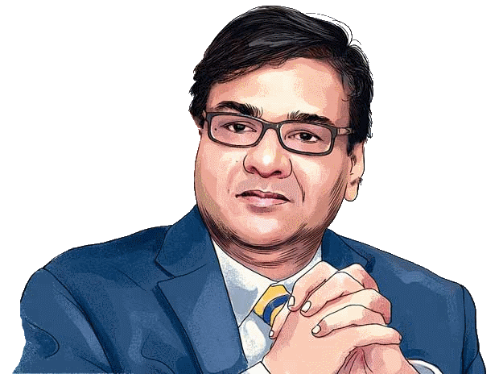
FSRASC- meant to recommend names for all members/chiefs for all regulatory bodies- SEBI, IRDA, MPC…
financial sector regulatory appointment search committee (FSRASC) ‘2015
Cabinet Secretary (IAS)
Addl. Principle Secretary to PM (IAS)
1 Secretary from FinMin (ecoaff/finservice)
3 outside experts
Chairman of given regulatory body
FSRASC under Cabinet Secretary PK Sinha (IAS)
Appointments Committee of the Cabinet (ACC)
3 year term: sept 2019
Notes:
http://www.hindustantimes.com/business-news/urjit-patel-s-appointment-as-rbi-governor-signals-change-in-govt-approach/story-TgUmnqgsMyrDep6pT9q4QJ.html

Slide 22
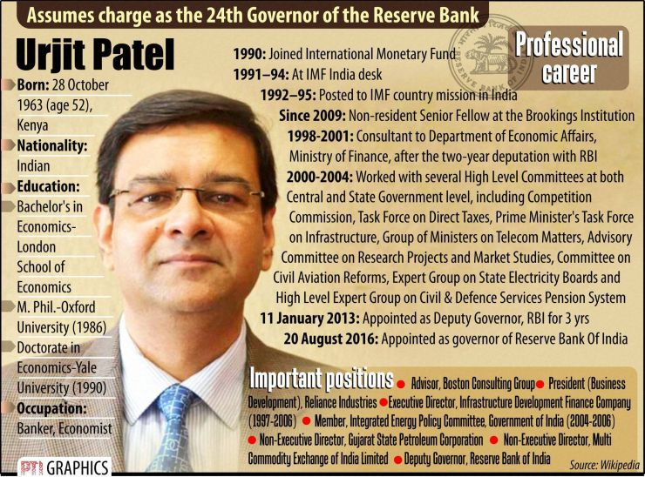

Slide 23
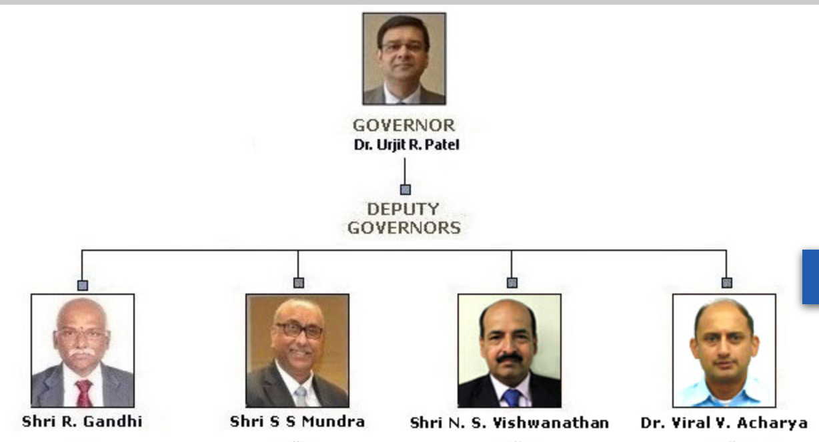

4 Regions
Northern: Delhi
Eastern: Calcutta
Southern: Madras
Western: Bombay
RBI act section 8: provides for “NOT MORE than 4” Dy. Gov
Joined RBI in ’82
3 years term.
Earlier exec.Dir
LATEST
[he replaced R.Gandhi]
Joined RBI in 80s
Ex CMD of BoB
Joined RBI in 81
3 years term.
Appointment Committee of Cabinet

Slide 24



RBI Act-> MPC:6 members| quorum 4 members- incl. governor.
Dy. Governor heading the Monetary Policy Department
Dr.Urjit Patel [Ex-officio Chairman, Casting vote]
RBI side
Chetan Ghate, @Indian Statistical Institute;
Govt Nominated [4 year term; no reappointment]
Pami Dua, @Delhi School of Economics
Ravindra H Dholakia @IIM-A
Dy.R. Gandhi [MP Dept]
Exe.Dir. Michael Patra [nominated by RBI central board]

Slide 25
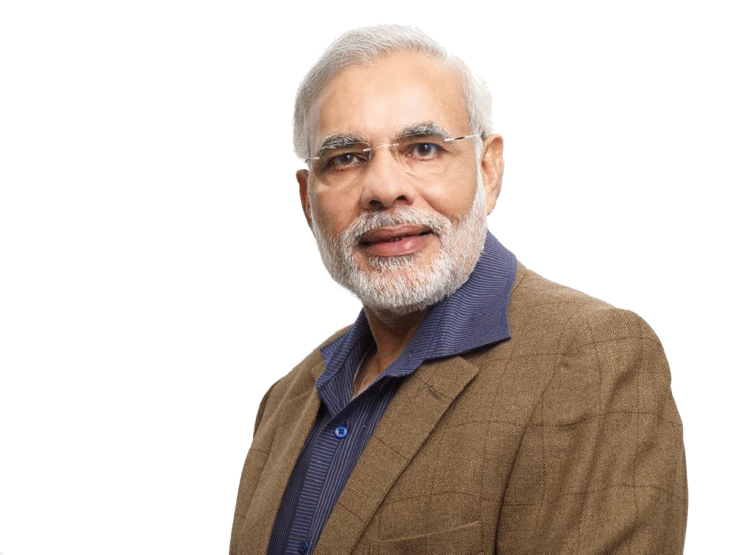
RBI’s Central Board
Latest Edition (2017, May)
CFO (Chief Financial Officer,CA)
Read Article
Non-Official
Nominated by Gov* link
Official Directors
Gov
4 Dy.Gov
1 Gov
…
4 DyGov
Executive Directors
Princi.CGM
Chief GM
GM
Dy.GM
staff
Notes:
CFO will also formulate the accounting policy of the bank, maintain the internal accounts and report financial results, and carry out corporate strategy functions like PF policies.

Slide 26
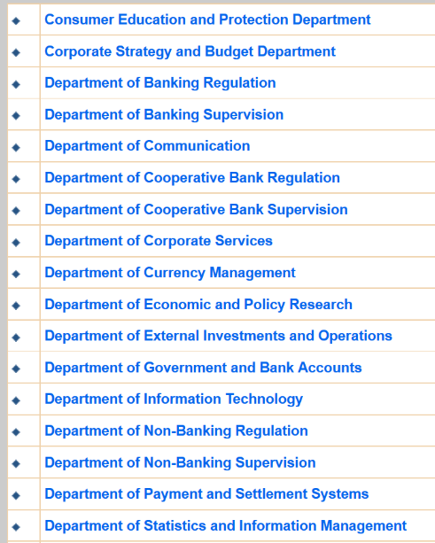
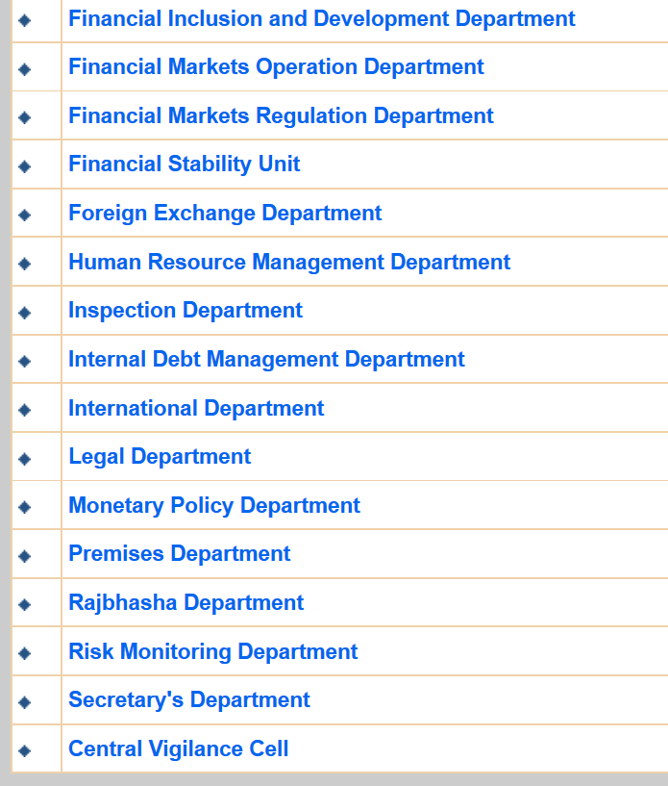

RBI departments
Notes:
33 departments it seems!
Consumer Education and Protection Department
Corporate Strategy and Budget Department
Department of Banking Regulation
Department of Banking Supervision
Department of Communication
Department of Cooperative Bank Regulation
Department of Cooperative Bank Supervision
Department of Corporate Services
Department of Currency Management
Department of Economic and Policy Research
Department of External Investments and Operations
Department of Government and Bank Accounts
Department of Information Technology
Department of Non-Banking Regulation
Department of Non-Banking Supervision
Department of Payment and Settlement Systems
Department of Statistics and Information Management
Financial Inclusion and Development Department
Financial Markets Operation Department
Financial Markets Regulation Department
Financial Stability Unit
Foreign Exchange Department
Human Resource Management Department
Inspection Department
Internal Debt Management Department
International Department
Legal Department
Monetary Policy Department
Premises Department
Rajbhasha Department
Risk Monitoring Department
Secretary's Department
Central Vigilance Cell

Slide 27

RBI’s new Enforcement Dept: from operational perspective?
BEFORE
Each dept. individually took action.
AFTER 1st April 2017
These “other” Departments will feed surveillance to “Enforcement” Department
Banking Regulation,
Payment Settlement,
Foreign Exchange,
Cooperatives…
=Centralized action, DBM.

Slide 28
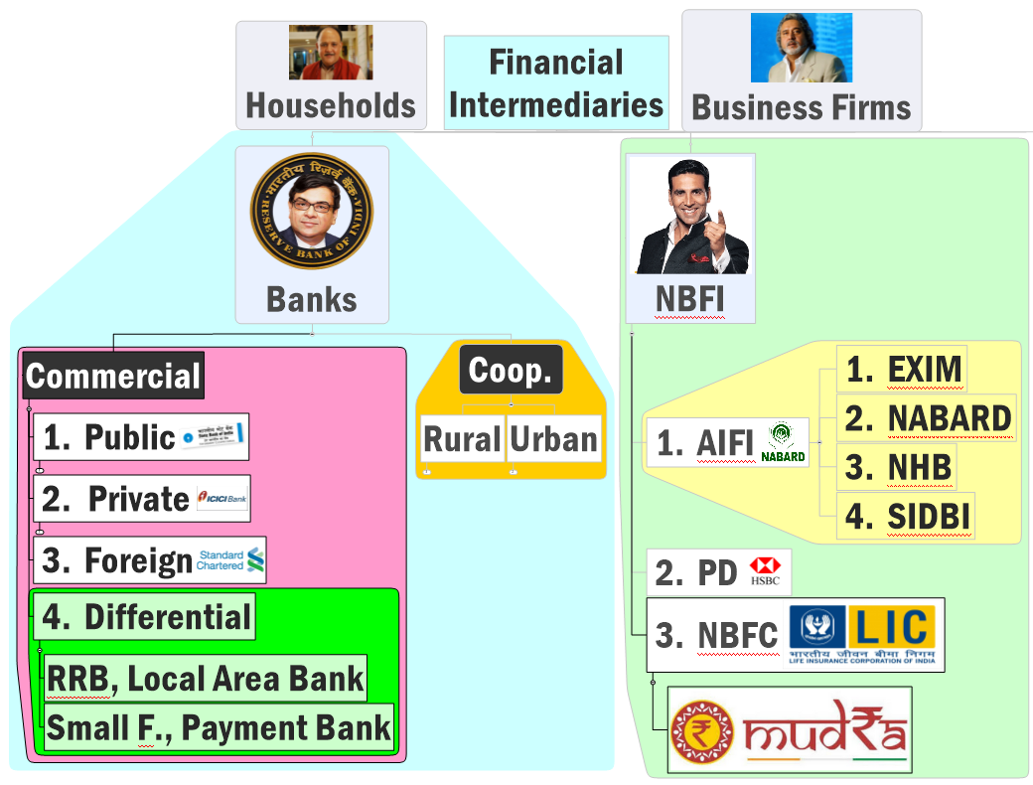

Origin
Structure Functions
Nationalization
“MERGERS”?

Slide 29

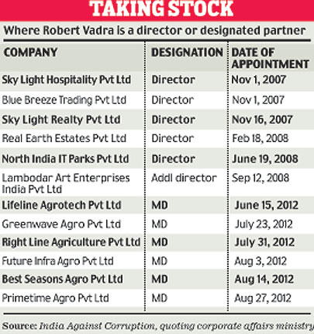

Post Independent India: Towards Nationalization of Private Banks
Notes:
http://indiatoday.intoday.in/story/robert-vadras-reality-empire-skylight-hospitality-pvt-ltd/1/223737.html

Slide 30
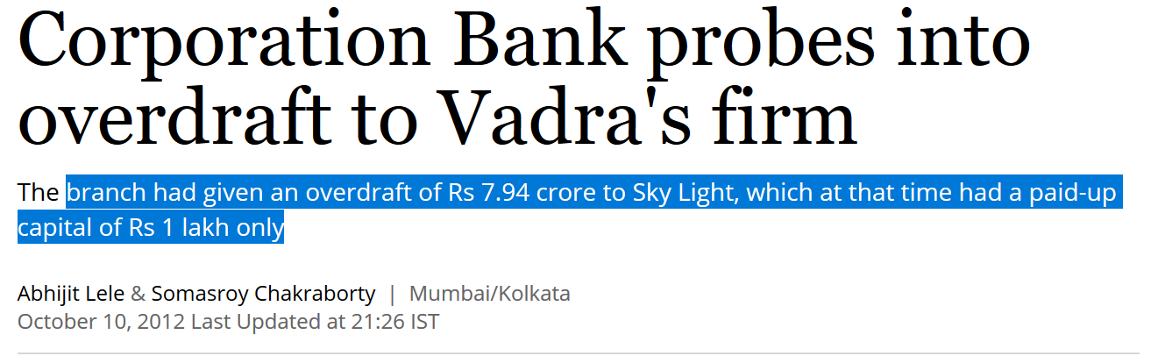
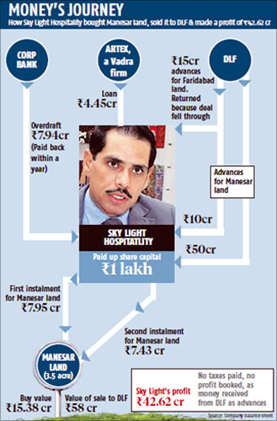
Overdraft / loan from bank
Speculative Investment in land, metals, commodities
Windfall gains
Open new companies
Notes:
http://www.rediff.com/money/slide-show/slide-show-1-inside-story-of-vadras-realty-business/20121010.htm

Slide 31
Why nationalize private banks?
NEXUS between Banks and Industrialists
‘50-1963: 188 people were in board of top 20 banks, 1452 companies, and numerous insurance, finance companies, NGO, trust.
Financial Inclusion
Reckless lending to directors and their firms.
So, Banks failed frequently, even RBI close down unviable banks.-> actually decline in the no. of branches in this phase!
Free India was Poor India: deposits growth low, so, Private baks unwilling to open in small areas- can't recover money till long.
Financial inclusion of poor, farmers, MSME…X
Private banks helped in FYP targets….X
Notes:
“Imperial Bank” (SBI), PNB, BoB.
Focus: merchant, industrial houses
Rural penetration NO
Not lending to farmers, artisans, MSE
Help in FYP achievement NO

Slide 32
Nationalization of Private Banks owned by princes and industrialists
48
55
6 banks with 200 cr/> deposits
’69
80
14 banks with 50 cr/> deposits
Imperial Bank->SBI
RBI Transfer of Ownership Act
49
RBI given powers to regulate under Banking regulation Act
55-56
LIC Act took over chillar life insurance cos.
72-73
GIC Act- took over chillar non-life insu.cos
2013
Without nationalization- BMB as PSB

Slide 33
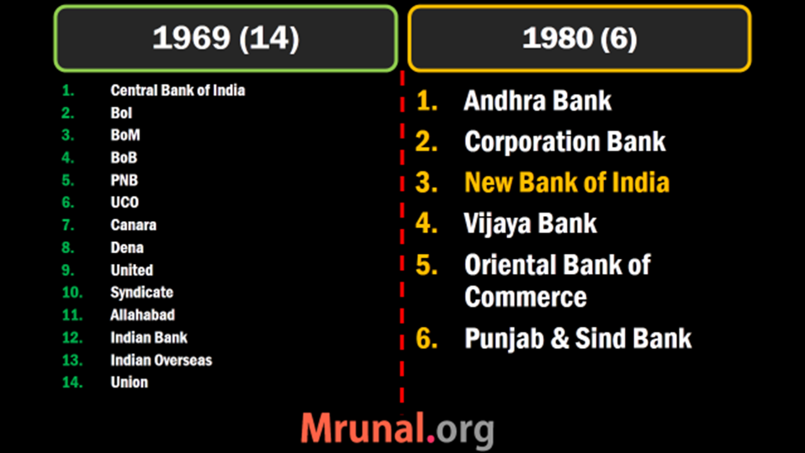

Deposit
50 cr/>
Deposit
200 cr/>
LEFT Out during nationalization drive
Catholic Syrian Bank (1920, Kerala) by 70s hardly 25 cr. Deposit, but Sch. 2 yes (paid up capital 5l)
And more….

Slide 34
So “old but not nationalized” type of “private” banks
“Big” Private Banks
50 cr />: round#1
200 cr />: Round#2
Small private Banks
<less than above figure
Catholic Syrian Bank Ltd
Dhanlaxmi Bank
RBL Bank
Tamilnad Mercantile Bank
City Union Bank
Federal Bank
Jammu & Kashmir Bank
Karur Vysya Bank
Lakshmi Vilas Bank
Nainital Bank
South Indian Bank
Karnataka Bank

Slide 35
Structure Functions
Nationalization
“Consolidation”

Slide 36



Competition & economies of Scale missing ☹
PSB in India
Telecom and civil aviation: Did not privatize BSNL/Air India, but allowed private entry= competition= Success
Same strategy in Banking: 3 rounds of licensing but competition => better service, profitability”
“Too big to fail” mentality among PSBs- high NPA > PVB. <REF NPA Lecture>
Gyan Sangam-II (Gurgaon/Gurugram-2016): Bank consolidation…SBI, BoB, PNB, Canara as anchor banks. Smaller banks to be merged in them.
Notes:
LPG-reforms: pvt. sector led growth, but majority finance not from pvt = “competition missing”
lack of sufficient internal competition
Private banks have slowly been brought into the arena since 1990.
It is important to note that India’s approach was not privatisation
of public sector banks, rather it was based on allowing entry of new private banks.
This strategy worked reasonably well in the telecommunication and civil aviation sectors but did it work in banking? The results have been mixed.

Slide 37

PSB: Merger + privatization = “consolidation” [एकत्रीकरण]
MERGED With SBI
Merger of BMB
IDBI Privatization
Merger of 5 Associate Banks of SBI

Slide 38


SBI owns ~75% to 100% in each of these banks
1913: Mysore
Maharaja of Mysore on M.Vishweshwariah (Bharat Ratna) Committee
40s: Bikaner & Jaipur
1917: Patiyala
1941: Hyderabad
Maharaja Bhupinder Singh
Nizam Mir Osman Ali Khan; Also issued Osmania Sicca
‘48: Operation Polo. [‘demonetization :-P]
43: Jaipur; 44: Bikaner => 63: merged
1945: Travancore
Diwan of Travancore, Kerala
MERGED
2008: Saurashtra
2010: Indore
SBI owns 90% shares
Listed @Bombay Stock Exchange
Associate Bank= a.k.a.
“खोपचे वाली” बेंक
Notes:
As of now Total PSB
21 PSB (incl.Mahila)+1 SBI +5 asso = 27

Slide 39


Given one year extension to implement
MD, Hyderabad
MD, Bik | Jai
MD, Travancore
MD, Mysore
SBI Chairman
MD, Patiyala
Announced plans to merge 5 asso. Banks + Bharatiya Mahila Bank. -2016 May
MD, core Banking
MD, National Banking
MD, Compliance & Risk
Notes:
Subsidiary banks?

Slide 40



Merger of Unlisted companies
SBI already owns 99%
You can always book on us
SBI already owns 99%

Slide 41




Share swapping for “LISTED COMPANIES” [Bank interviews]
28 shares of Rs.1 each
Rs.10’s 10 [=100]
Swap ratio: 2.8/1
Swap ratio: 2.2/1
Mottos imp for Bank exams
Swap ratio: 2.2/1

Slide 42
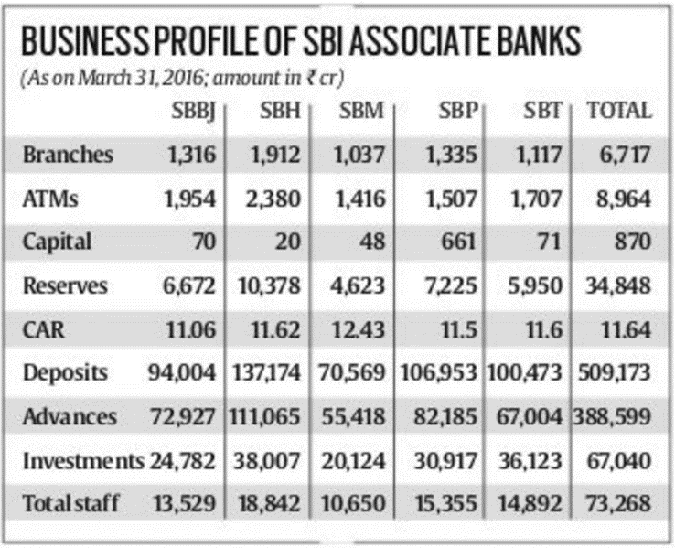

Merger of Associate banks WEF 1/4/2017
offered VRS ahead of merger

Slide 43
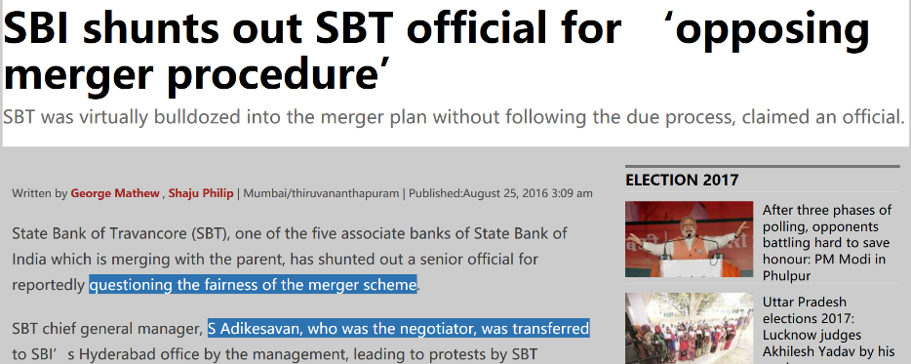
For bank interview, self-study on operational aspects post-merger. For UPSC let’s directly jump to pros and cons..

Slide 44
Merger of Associate banks with SBI
CRITICISM
2008-09: SBS (Saurashtra) merger led to 3 years seniority loss. – promotion, increments. ☹
Unnecessary VRS and bad loans = costs.
Kerala Legislative Assembly: SBT merger - state’s economic growth affected negatively.
SBM - “loosing identity” & intelligence (Transfer of employees)
Some current account holders may shift to other regional banks for faster service and personalized privileges (e.g. cash salary on Diwali with chillar / ATM.)

Slide 45

BENEFITs Pro-Arguments
MERGER
Earlier State Bank of Saurashtra (2008) and Indore (2010) were merged with SBI
MERGER: geographical & technological synergies, economies of scale ▲;
▼ NPA; ▼ recapitalization requirements for BASEL-III norms
Even if NPA (!▼), still ‘bigger bank’s’ recapitalization bond/preferential shares will get better response from market.

Slide 46
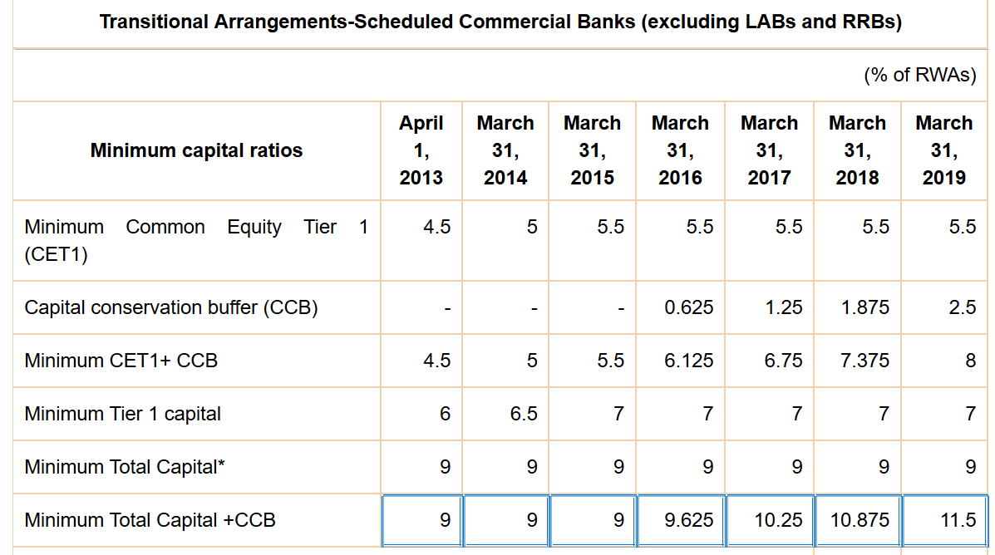

BASEL-III norms CRAR. [but hairsplitting useless for UPSC]
Banks have to build capital buffers outside the period of stress. [Counter cyclic- CCCB is separately prescribed]
CRAR: 9% only
11.5% CRAR+CCB. Can get even higher if RBI prescribes CCCB
Notes:
https://rbi.org.in/scripts/NotificationUser.aspx?Id=8806&Mode=0

Slide 47
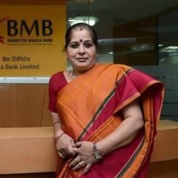
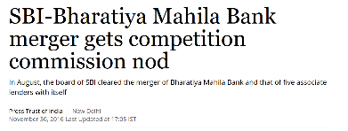
Bharatiya Mahila Bank (2013) HQ: New Delhi.
Last Airbender PSB
Budget 2013; 1000 crore Rs. (100% State Owned)
MBN Rao Panel blue print (Canara)
Nothing new: 80s Pak, Tanzania 2009
Not new even in India- already urban cooperative banks for women
Usha Anantha-Subramanian was first and last CMD-> then only SM Swathi (ED) then merged with SBI
BoD=all women. <abolished post-merger>
Staff, deposit= male + female; BoB, PNB deputation.
Loan => predominantly to women.
loans up to Rs 1 crore without collateral to women
Skill development, financial literacy among women.
Most banks use Finacle by Infosys or BanCS by TCS.
BMB: Core Banking Software by FIS (American Co.)
Bit more interest on savings account
Vision 2020-700+ branches, 60k cr biz.
Originally specialist officer in BoB
..CMD BMB
Later CMD of PNB

Slide 48

Merger of (unlisted) Bharatiya Mahila Bank WEF 1/4/17
BMB flawed idea. Hardly 4-5 branches in each state. Instead of making more losses by expansion-> better stop.
It will not hurt “women empowerment” because ….<NEXT SLIDE>
4.42 cr shares
100% ownership
Govt owns 100%

Slide 49
Why BMB merger will not hurt women empowerment?
Bank
SBI
BMB
Not even that many customers!
Women exclusive branch
126 out of 20k+
7 out of 103
Women staff
Loans given to women
Rs.46k cr
Only 192 cr. ☹
22% of 2 lakh

Slide 50
PSB: Merger + privatization = “consolidation” [एकत्रीकरण]
With SBI
Merger of BMB
IDBI Privatization
Merger of 5 Associate Banks of SBI

Slide 51

Budget 2016
IDBI
IDBI Bank ltd. (Govt ~73%)
Budget 2016: may ▼ Shareholding to <50% in IDBI Bank ltd.
Will be transformed like UTI-> Axis Bank
Notes:
1964: Industrial Development Bank of India (IDBI) - a developmental financial institution [DFI] under RBI
1993: separate commercial Bank
1998: Narsimhan-II: no DFI

Slide 52
UTI MF (‘63)-> UTI Bank (‘93)->
UTI Bank
UTI Bank Post Ketan Parekh
Special undertaking of UTI (SUUTI)
2001: Ketan Parekh scam
Govt bailed out UTI-> Special undertaking of UTI (SUUTI):
$1.6 bn from Commonwealth dev.corp. (Actis corp) -> BoD seats.
SUUTI- demanded royalty to use “UTI” brand name.->
P J Nayak- came with “AXIS”

Slide 53


UTI MF (‘63)-> UTI Bank (‘93)-> Axis Bank (2007)
Govt Owned | Stakes in Axis
Life Insurance Corporation of India | 14%
SU-Unit Trust of India | 12%
General Insurance Corp of India | 1.67%
New India Assurance Company | 1.09%
Notes:
https://www.axisbank.com/shareholders-corner/financial-results-and-other-information/quarterly-results/stock-information

Slide 54
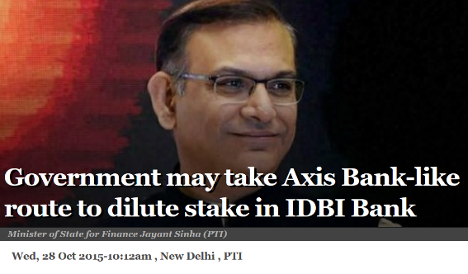
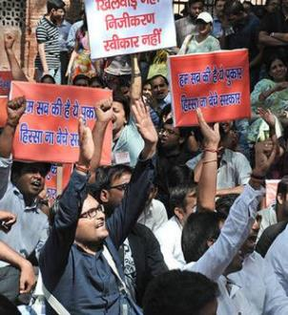

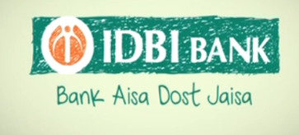

Slide 55
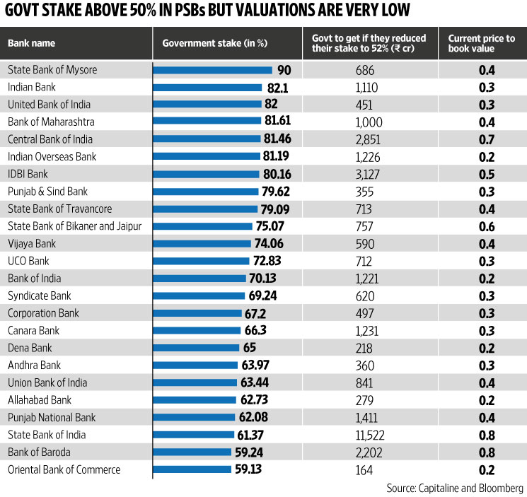
Due to NPA, PSB shares are down so selling won’t fetch…good money.

Slide 56

PSB: Merger and privatization = “consolidation” [एकत्रीकरण]
With SBI
Merger of BMB
IDBI Privatization
Merger of 5 Associated Banks of SBI

Slide 57
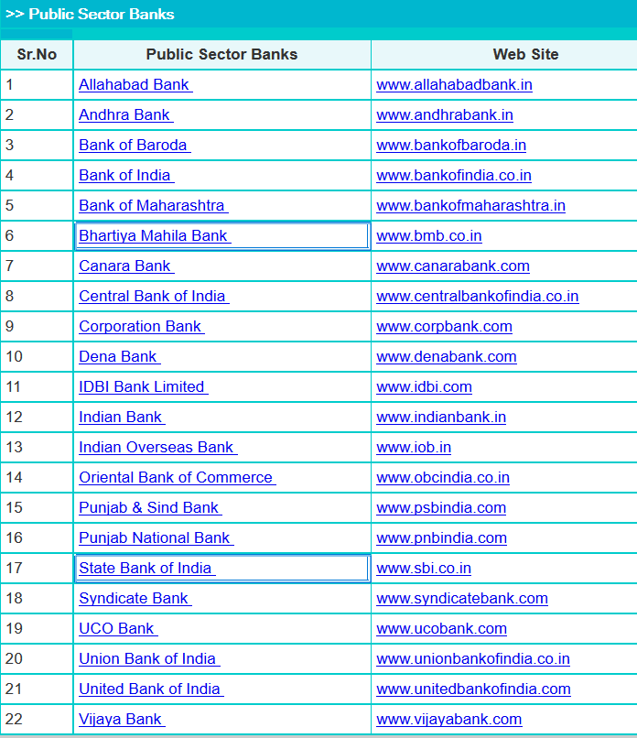
How many public sector banks in India?
Total 22
Naa…Total 27
20 + 1 SBI + 1 BMB = 22
20 + 1 BMB + (1 SBI + 5 Asso Banks) = 27- 6= 21
Naa…only 20 in future
27 – 1BMB -5 Asso. – 1 IDBI=20

Slide 58

Origin
Structure Functions

